Slide 1
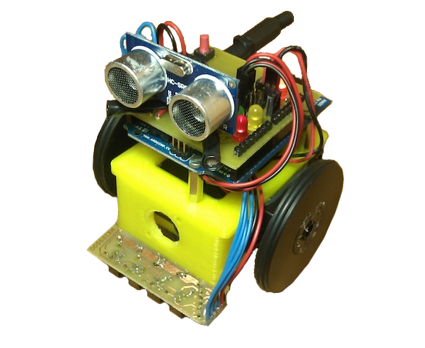
Lesson 4 – Using the line sensor
ArduSkyBot 2012 Summer Workshop
Today you will learn:
What is the line sensor and how it works.
How to assemble and test the line sensor.
Make the ArduSkyBot follow a line!
Organized by: Carlos García Saura
July-August 2012

Slide 2
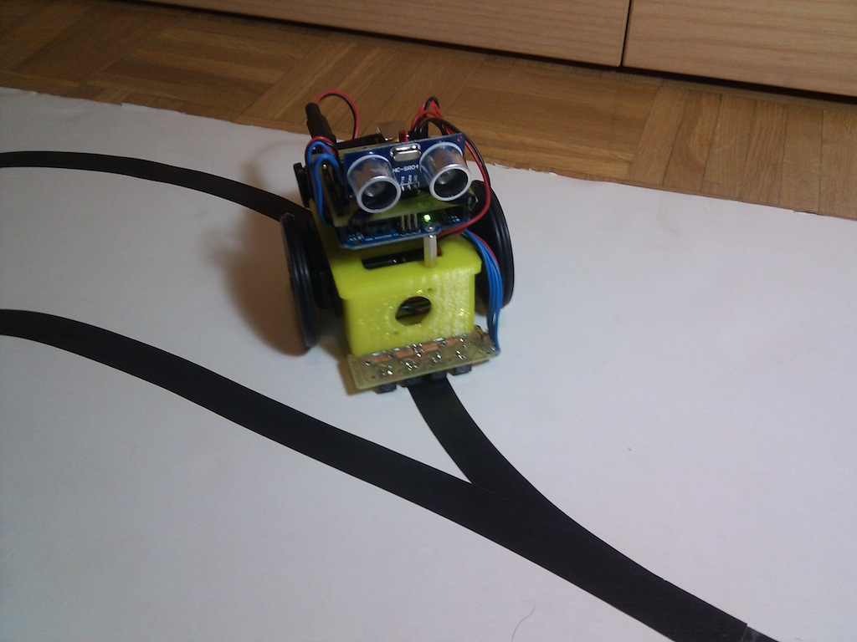
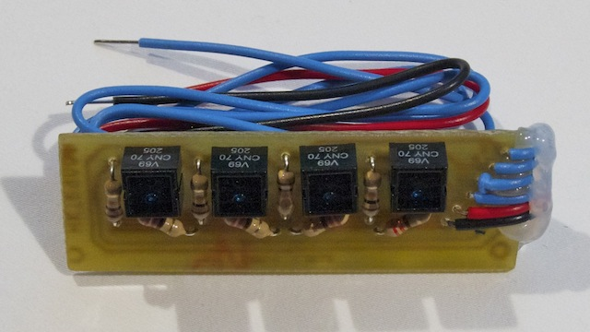
What is the line sensor?
CNY70 sensors
The software reads “1” if a CNY70 sensor reads white, and “0” when it reads black

Slide 3
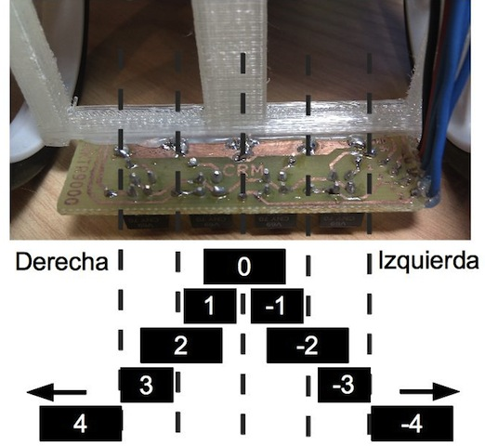
How it works?
With four sensors, we can know the position of the black line in the floor.
The read_line() function returns a number that indicates the position of the line.
We can use this number to drive our robot with the robot_heading() function!
RIGHT
LEFT

Slide 4
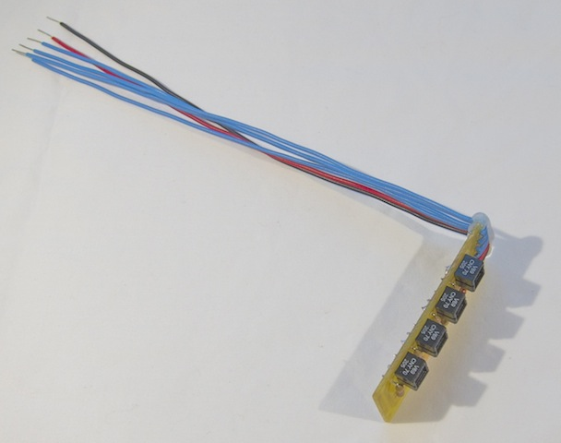
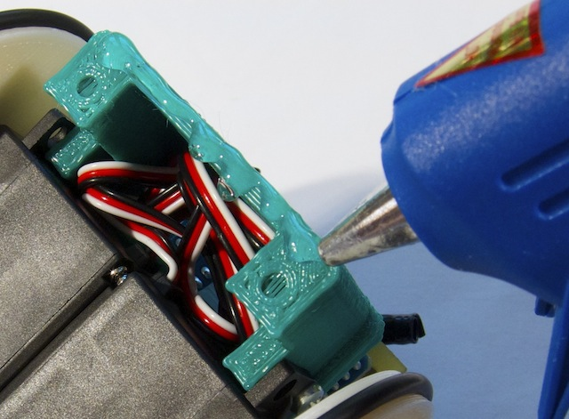
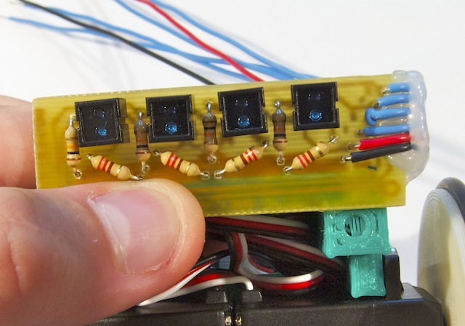
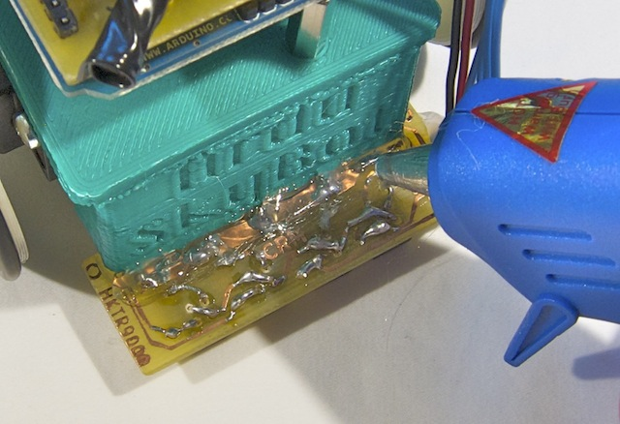
Assembly of the line sensor

Slide 5
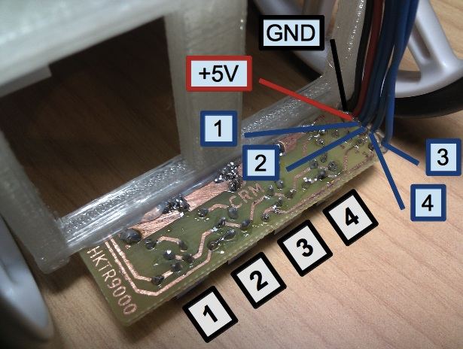
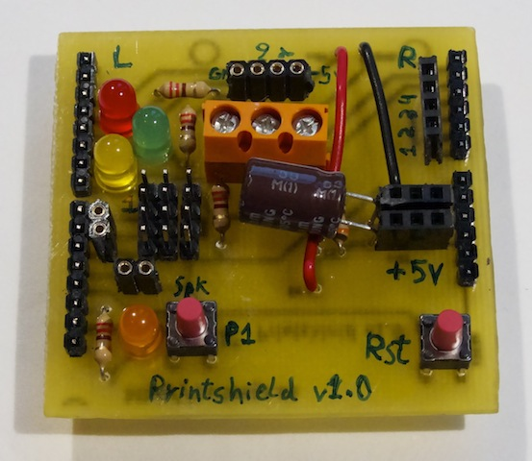
Printshield connections
Line sensor wires:
4
3
2
GND
1
+5V
-
+
Make sure to connect the wires in the proper order!

Slide 6
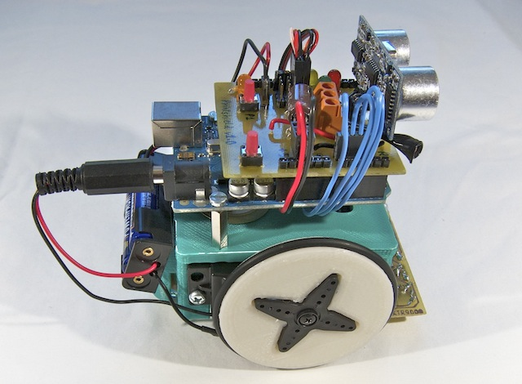
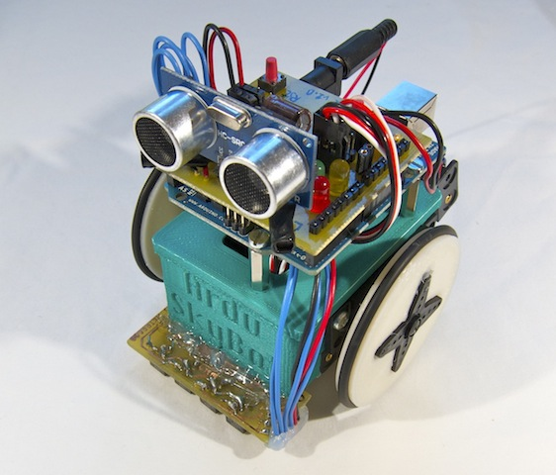
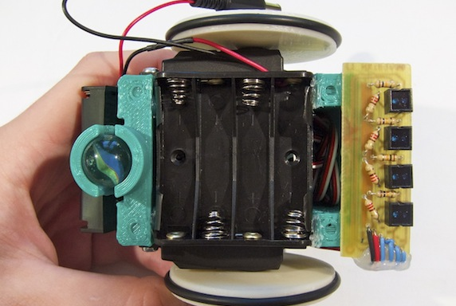
You have finished the ArduSkyBot!
Try to place the wires properly so the robot is compact

Slide 7
Programming time!
Download the testing and example code from
http://www.carlosgs.es/2012-summer-workshop

Slide 8

License
This work is licensed under the
Attribution - Share Alike
Creative Commons license.
http://creativecommons.org/licenses/by-sa/3.0/
Author:
Carlos García Saura

